Slide 1




AirPure Innovations
Product-Market Fit Research for Air Purifiers
Leveraging AQI Analytics for Strategic Development
Presented by
AVIK SARKHEL

Slide 2
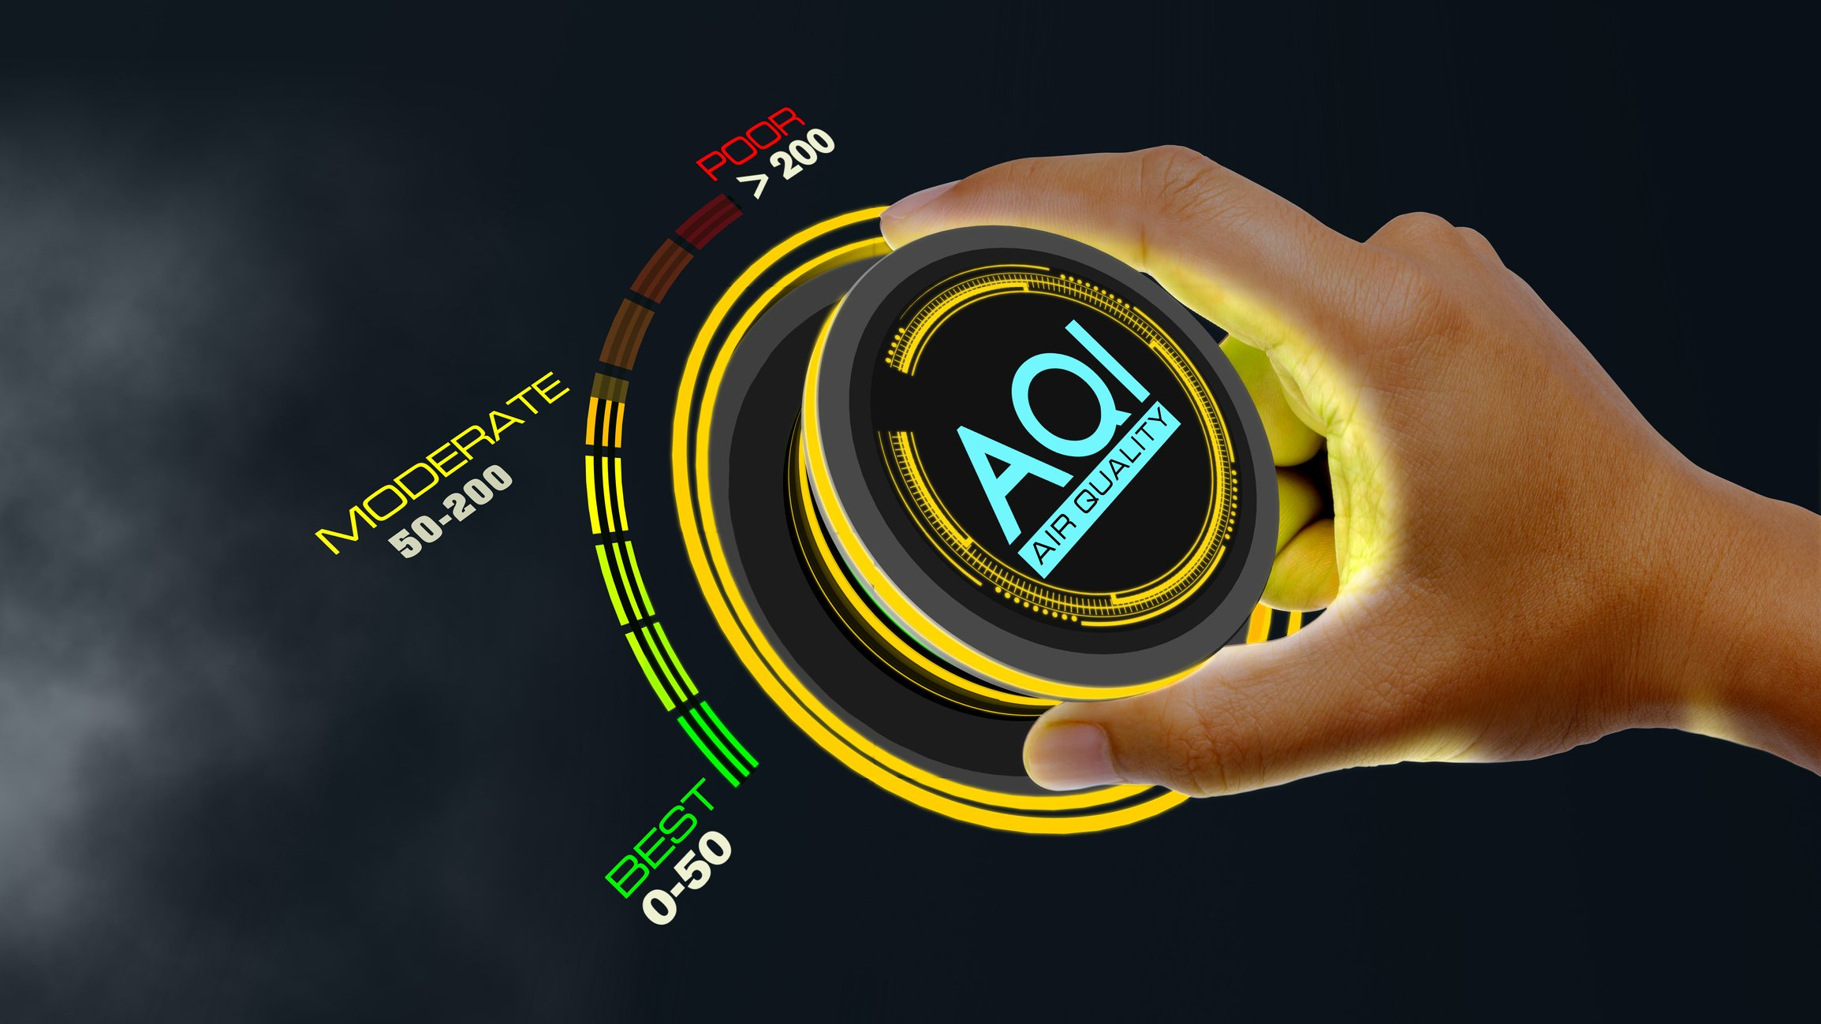

Project Overview
This project is part of the Codebasics Resume Challenge — Air Purifier Product-Market Fit Research.
Analyzed air quality trends across India (2022–2025) to support air purifier product development.
Explored the impact of pollution on health, vehicles, population, and regional differences.
Utilized Python (Pandas, Seaborn, Matplotlib) for analysis; prepared results in Google colab notebook.

Slide 3
DataSets Used
All datasets were provided by DATAFUL, the sponsor of this Codebasics Resume Project Challenge.
AQI Data (2022–2025): Air Quality Index values, pollutants, station counts.
Health Dataset (2022–2025): Disease outbreaks by location, cases, deaths.
Vehicle Dataset (2022–2025): Registration data by fuel type/class.
Population Dataset (2011–2036): State-wise monthly population data

Slide 4

Data Cleaning & Standardization
Removed irrelevant/redundant columns and handled missing values through imputation or removal.
Standardized fuel types (grouped electric & hybrid) and clarified ambiguous “N/A” values.
Unified disease names and corrected typos for consistent health data analysis.
Standardized state names, removed “All India” rows, and aligned date formats.
Validated pollutant names/categories to avoid duplication and ensure accuracy.
Note: Full detailed cleaning steps in my Google Colab notebook (link at end of PPT).

Slide 5

01
Primary Analysis
Exploring Key Air Quality Insights Across India

Slide 6
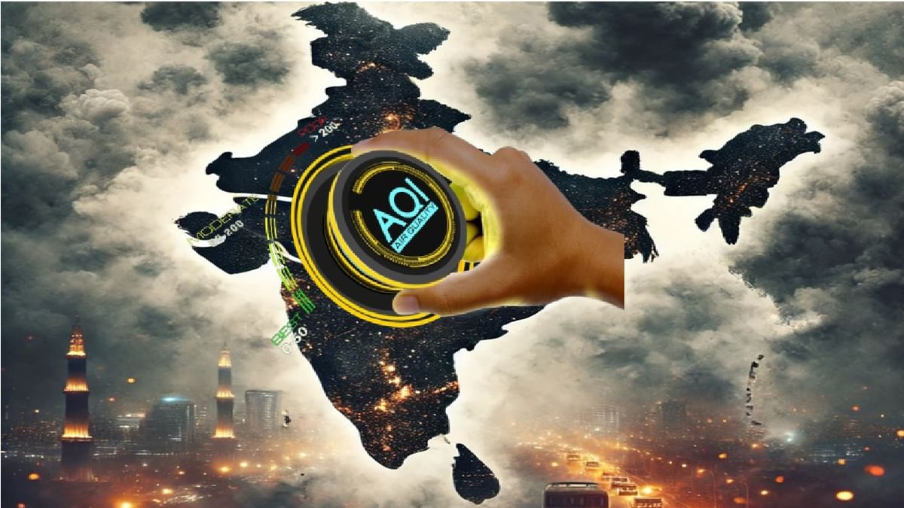
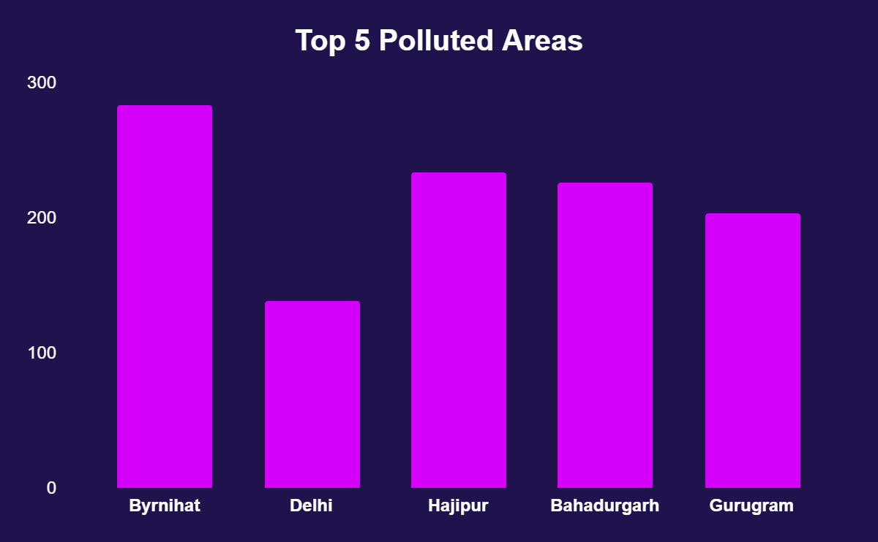
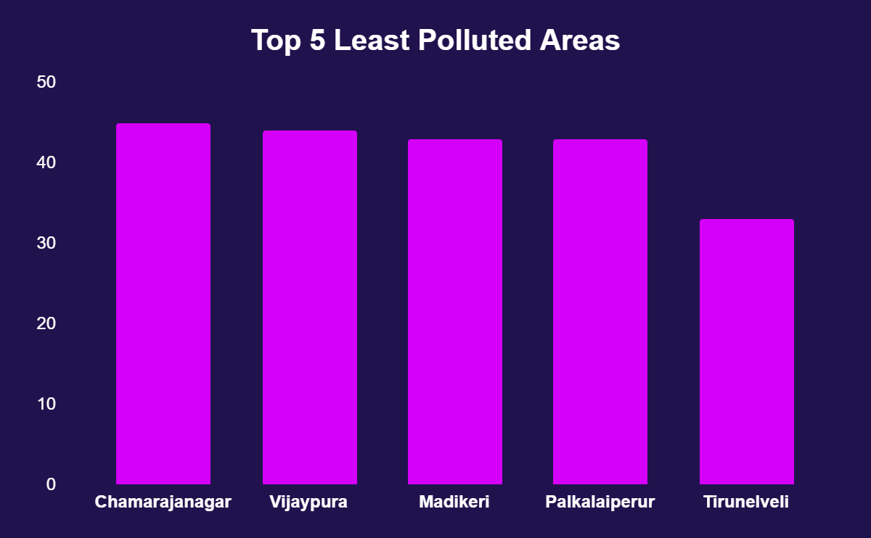
Q1 – Top & Bottom Areas by AQI (Dec 2024 – May 2025)
Worst Air Quality: Byrnihat, Delhi, Hajipur, Bahadurgarh, Gurugram (Avg AQI 200–284)
Best Air Quality: Chamarajanagar, Vijayapura, Madikeri, Palkalaiperur, Tirunelveli (Avg AQI 33–45)
Insight: NCR, Bihar, and Haryana are the most polluted; southern regions maintain cleaner air quality.

Slide 7
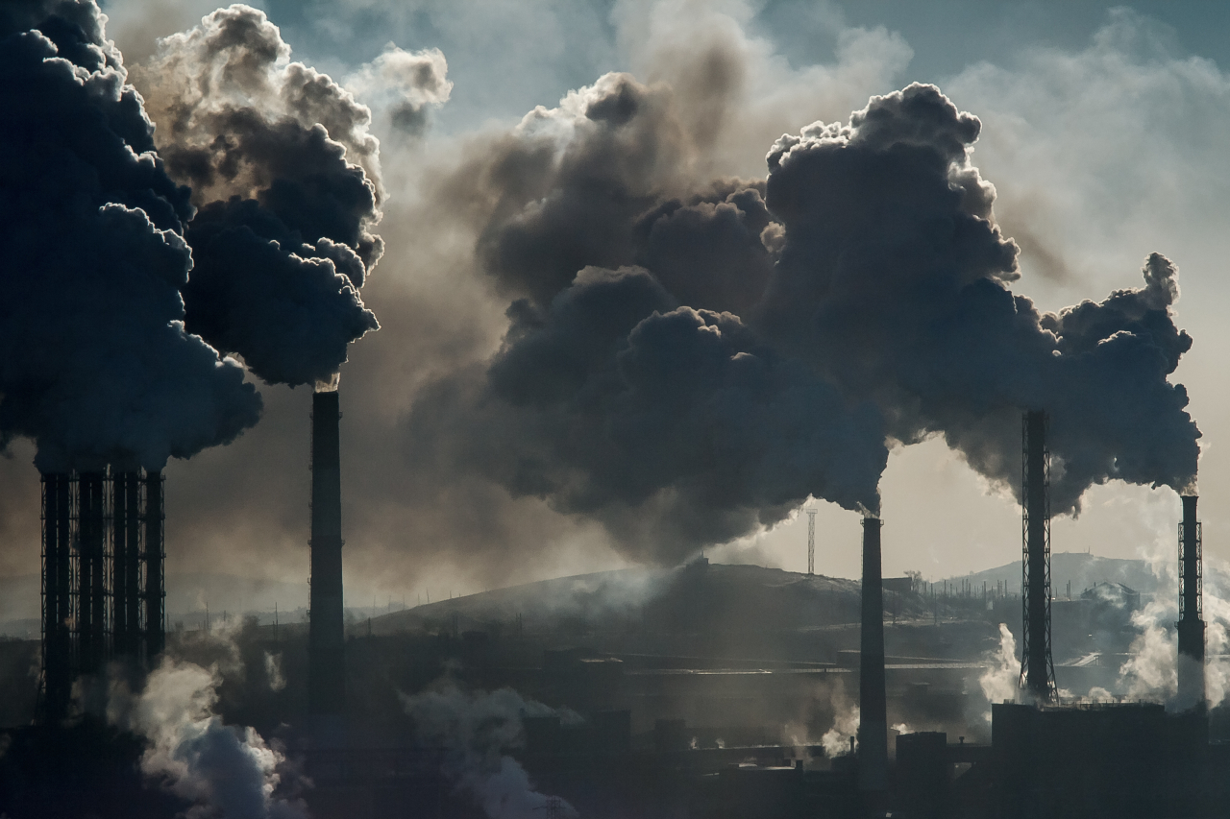
Q2 – Southern India Air Quality Analysis (Post-2022)
Top 2 Pollutants – Insights
PM10 & PM2.5 dominate in most Southern states → key air quality concern.
Karnataka: CO as 2nd top pollutant.
Puducherry: O3 as 2nd top pollutant.
Andaman & Nicobar: PM10 & CO with low overall counts.
Bottom 2 Pollutants – Insights
Vary by state: NO2, SO2, O3, CO, NH3, SO3.
Puducherry: PM2.5 among bottom pollutants.
Andaman & Nicobar: very low PM2.5 & O3 counts.
Note: The detailed visualization for this analysis can be found in my Google Colab notebook (link provided at the end of this presentation).

Slide 8
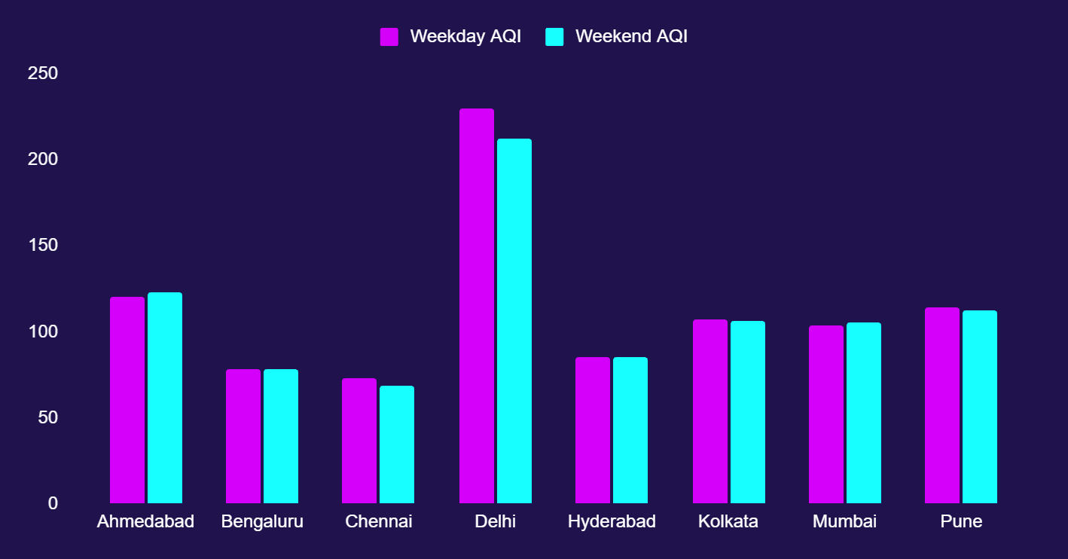
Q3 - AQI Trends Weekends vs Weekdays in Major Indian Metro Cities
Improves on weekends: Delhi, Chennai, Bengaluru*, Kolkata*, Pune* (*slight).
Worsens/no change: Ahmedabad, Hyderabad, Mumbai.
Key takeaway: No uniform weekend improvement — patterns vary by city.
Reason: Differences in pollution sources, traffic patterns, and local weather.

Slide 9
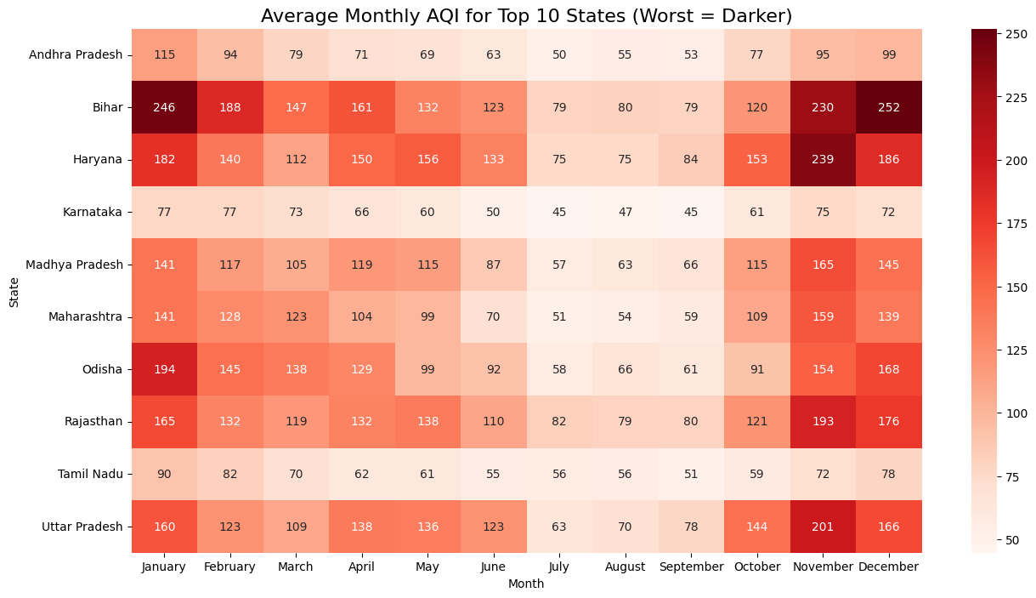
Q4 – Worst Air Quality Months Across States
Winter months (Oct–Jan) show highest AQI (150–250+), driven by temperature inversion, stubble burning, and higher emissions.
Severely affected states: Bihar, Haryana, Uttar Pradesh, Rajasthan, Odisha, Madhya Pradesh, Maharashtra.
Milder impact: Andhra Pradesh; good year‑round air: Tamil Nadu, Karnataka.
Best air quality: Monsoon season (Jun–Sep) when rains wash out pollutants.

Slide 10
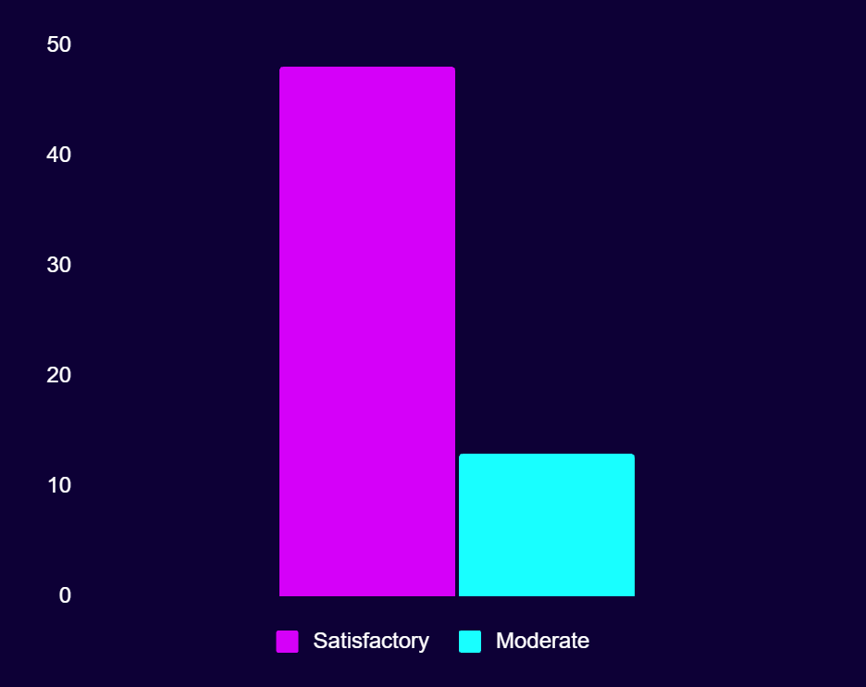
Q5 – Bengaluru Air Quality (Mar–May 2025)
Satisfactory: 48 days (78%) – Generally clean air; minor effects possible for sensitive groups.
Moderate: 13 days (22%) – Acceptable but may cause mild discomfort for sensitive individuals.
Key Takeaway: Air quality remained predominantly healthy during this period, reflecting Karnataka’s overall cleaner air compared to Northern states.

Slide 11
Q6 – Top 2 Most Reported Diseases & AQI by State (Past 3 Years)
Diarrheal diseases dominate in many states (e.g., Andhra Pradesh, Chhattisgarh, Karnataka, Maharashtra, West Bengal), reflecting persistent waterborne infection and sanitation challenges.
Food poisoning is a frequent secondary disease burden, notably in Kerala, Gujarat, and Odisha, indicating food safety concerns.
Vector-borne diseases like dengue and malaria remain significant in northeast and northern states (e.g., Manipur, Jammu & Kashmir, Bihar, Jharkhand), underscoring the need for expanded vector control.
Respiratory and viral outbreaks occur locally, including measles in Meghalaya and fever with rash in Andaman & Nicobar Islands; vaccination and preparedness are vital.
AQI comparison: High pollution states (Delhi, Bihar, Jharkhand) face compounded health risks with respiratory and infectious diseases; cleaner air states (Mizoram, Puducherry) still report prevalent foodborne illnesses.
Unique diseases such as Crimean Congo Hemorrhagic Fever, Monkey Pox, and Hand-Foot-Mouth Disease appear in select regions, highlighting the importance of specialized surveillance.
Integrated public health interventions addressing sanitation, vector control, food safety, and air pollution reduction are critical for improving health outcomes.
Note: Detailed visualizations supporting this analysis are available in the Google Colab notebook linked at the end of this presentation.

Slide 12
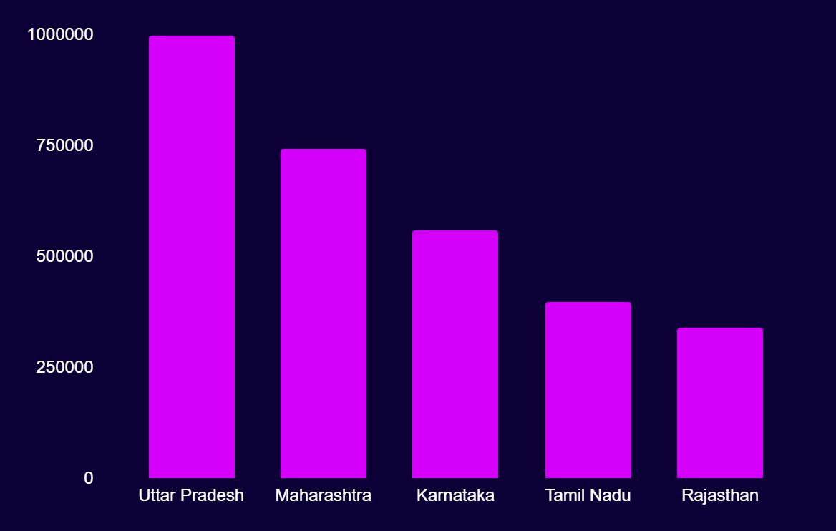
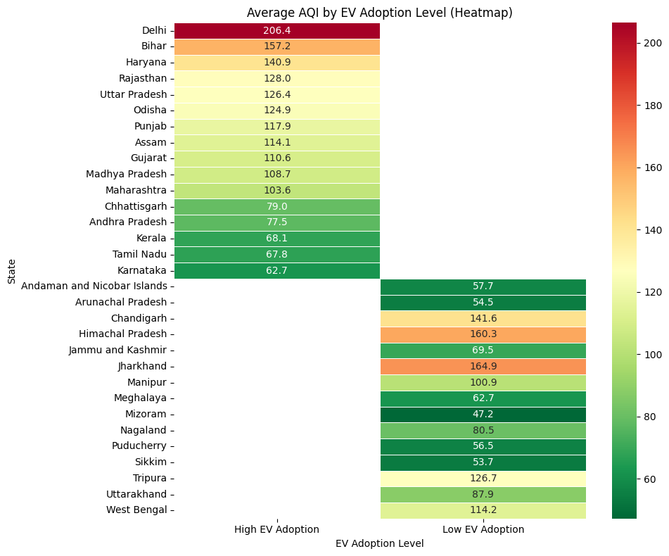
Q7 – EV Adoption and Air Quality Analysis
Top EV states: Uttar Pradesh, Maharashtra, Karnataka, Tamil Nadu, Rajasthan.
High EV states still have poor AQI (e.g., Delhi 206, Bihar 157, UP 126) → adoption likely driven by high pollution.
Low EV states often have cleaner air (e.g., Mizoram 47, Sikkim 54, Andaman 58).
Conclusion: EV adoption alone hasn’t improved AQI; needs to be paired with broader pollution control.

Slide 13
02
Secondary analysis
Additional insights beyond the primary AQI trends.

Slide 14
Q1 – Vulnerable Age Groups & Citywise Variation
Most affected:
Children <5 yrs – highest respiratory illness risk from PM2.5.
Elderly (65+) – higher chronic disease complications & mortality.
Other at‑risk groups: Pregnant women, infants, people with pre‑existing respiratory/cardiac issues.
Working‑age adults (15–64): Lower risk, except during severe pollution or occupational exposure.
City patterns:
Delhi NCR: Highest health impact on kids & elderly.
Other metros: Similar trends during seasonal peaks.
Urban > Rural: Higher ambient exposure in cities; rural faces household air pollution.
Supporting References (Hyperlinked):
Economic Times: Air pollution significantly increases death risk across all age groups in Indian districts
The Lancet: Study on ambient PM2.5 pollution & respiratory illness in children under 5 across India
Hindustan Times: PM2.5 and household pollution increase deaths among newborns and children
Down To Earth: Pediatric respiratory disorders linked to pollution
Frontiers in Sustainable Cities: Long-term effects of PM2.5 in Indian metropolitan cities
Ministry of Health & Family Welfare, India: Advisory on Air Pollution and Health

Slide 15
Q2 – Major competitors in the Indian air purifier market, and along with their key differentiators
Brand | Price Range | Filtration Stages | Smart Features | Key Differentiators
Dyson | RS 30,000 - RS 60,000+ | 3-5 (HEPA, activated carbon, formaldehyde) | Wi-Fi, App, Voice Assistants, Real-time AQI, Bladeless fan | Innovative design, multifunctional, high CADR, digital display
Philips | RS 15,000 - RS 40,000 | 3 (HEPA, activated carbon, pre-filter) | App Control (some), AQ sensors, Auto/Night Mode | Trusted brand, efficient & quiet, good service
Xiaomi | RS 8,000 - RS 20,000 | 3 (HEPA, activated carbon) | App, Real-time AQI, Smart Home, Voice Control | Affordable, strong smart ecosystem
Honeywell | RS 12,000 - RS 30,000 | 3-5 (HEPA, activated carbon, anti-bacterial) | AQ sensors, Auto Mode, Timer, App/Alexa (some) | Durable, strong filtration, advanced options
Blue Star | RS 10,000 - RS 27,000 | 3 (HEPA, activated carbon, pre-filter), Ionizer | AQ indicator, Auto, Sleep Mode, Filter alert | Cost-effective, robust filters, local focus

Slide 16
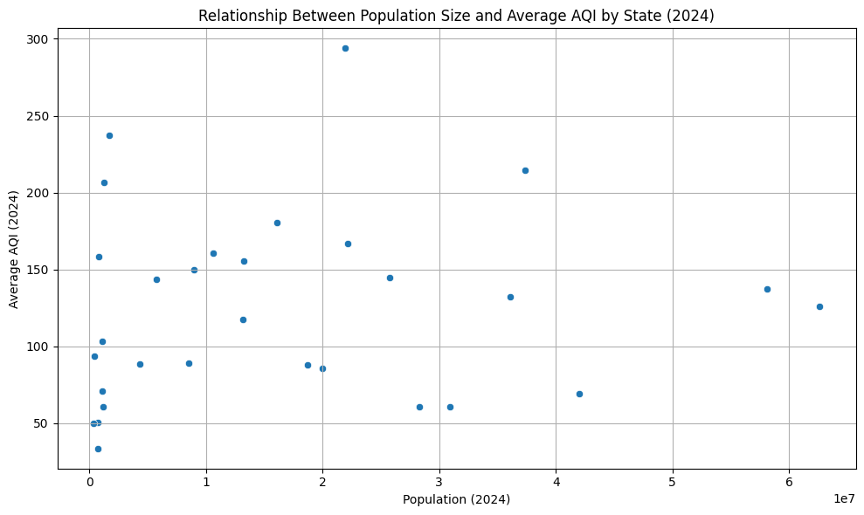
Q3 – Population Size vs Average AQI (2024)
High AQI in big & small states: Delhi & West Bengal (large) and Tripura & Chandigarh (small) all show poor air quality → local sources & geography matter.
Clean small states: Mizoram, Sikkim, Meghalaya have low AQI due to low industrialization & favorable geography.
Large & clean example: Karnataka has a big population yet maintains low AQI (~61) thanks to coastal climate and dispersed urban areas.
Takeaway: AQI is shaped by industrial activity, geography, weather, and emission controls — not population size alone.

Slide 17
Q4 – Awareness and Understanding of AQI in India (2025)
High in metros (Delhi, Mumbai, Bengaluru, Kolkata) due to apps, media, govt alerts.
Partial health understanding – people know poor AQI is harmful but lack detail on pollutant‑specific risks.
Urban–rural gap – smaller towns/rural areas have low awareness due to limited access & outreach.
Action mostly at extremes – precautions rise only during “poor/very poor” AQI days.
Data trust issues – inconsistent monitoring & info access reduce reliance on AQI data.
Supporting References (Hyperlinked):
India’s Metro Cities Air Quality and Health Impact, AQI.in Blog (2025)
Drishti IAS Analysis on Air Pollution Monitoring and Public Engagement (2025)
"Tracing the Hazy Air 2025" Report, CREA
Central Pollution Control Board (CPCB) National Air Quality Index Portal
Economic Times: Awareness about air pollution-related terminologies low among urban poor in Delhi-NCR: Study
Down To Earth: Public Understanding and Limitations on AQI Health Literacy

Slide 18
Q5 – Impact of Pollution Control Policies (Last 5 Years)
NCAP: Flagship program; reduced PM10 in most target cities, but improvement is uneven..
BS-VI norms & EV push: Cut vehicle emissions nationally.
Fuel bans & local actions: NCR bans pet coke/furnace oil; cities like Delhi use odd-even traffic rules & stubble burning controls.
Successes: Cities like Mumbai (34% PM reduction), Varanasi (70% PM2.5 drop) show strong gains.
Challenges: Many cities still exceed safe limits; impact varies by region due to differing enforcement, sources, and geography.
Supporting References (Hyperlinked):
Mixed Results From India's Five-Year Campaign To Cut Air Pollution
India’s PM2.5 Levels Decline Study - Down To Earth (2025)
Strengthening India’s Air Quality Management - Drishti IAS (2024)
Tracing the Hazy Air 2025: Progress Report on National Clean Air Programme (NCAP) – CREA
Economic Times: Awareness about air pollution-related terminologies low among urban poor in Delhi-NCR: Study
Ministry of Environment Forest and Climate Change (MoEFCC) and NCAP Progress Reports (2024)

Slide 19
03
Critical Questions
Deep‑Dive into Core Air Quality Challenges and Insights

Slide 20
Q1 – Air Quality Status and Trends in Major Indian Cities (2024)
Delhi – Worst polluted metro; winter PM2.5 ~175 µg/m³; frequent ‘severe+’ smog episodes from traffic, industry, stubble burning, and dust.
Kolkata & Hyderabad – High PM2.5 (Kolkata ~65 µg/m³ winters); Hyderabad showing worsening trend.
Mumbai, Chennai, Bengaluru – Cleaner due to coastal winds but facing local industrial/urban pollution rise.
Tier‑2 hotspots – Faridabad, Ghaziabad, Muzaffarnagar, Greater Noida >80 µg/m³; urgent intervention needed.
Byrnihat (Assam) – Emerging severe hotspot (~120 µg/m³), showing pollution is spreading beyond major metros.
Common trends – Minimal PM drop since 2019 in several cities, more ‘poor–severe’ days, and localized hotspots 20–60% worse than city averages.
Supporting References (Hyperlinked):
CSE 2024-25 Winter Air Pollution Analysis for Major Indian Megacities:)
Respirer Living Sciences “Towards Clear Skies 2025” Report
IQAir 2024 Indian City Pollution Rankings
News Coverage and Government Data

Slide 21
Q2 – AQI Spikes & Pediatric Asthma Admissions
Strong correlation found between spikes in PM2.5, PM10, and NO2 and increased hospital admissions for pediatric asthma and respiratory illnesses.
Mysore study: A 10 µg/m³ rise in NO2 linked to a 2.42% increase in daily pediatric asthma admissions; PM10 levels showed a linear increase in asthma cases.
Ahmedabad and other regions: Seasonal pollution spikes, especially in winter and during crop stubble burning, correspond with higher respiratory admissions in children.
Mechanism: Fine particulates (PM2.5) cause lung inflammation and oxidative stress, triggering asthma attacks; NO2 acts as a respiratory irritant.
Public health implication: Urgent need for targeted pollution control during high pollution episodes to protect vulnerable children; continuous monitoring and health data integration essential.
Supporting References (Hyperlinked):
Effects of Ambient Air Pollutants on Hospital Admissions in Children (Mysore, India)
Impact of Air Pollution on Allergic Rhinitis and Asthma (Indian Pediatrics)
Linking PM Pollution to Respiratory Health of Children (Ahmedabad Study)
One in every two children in Kolkata suffers from air pollution: Impact on pediatric asthma
Air Pollution and Childhood Asthma - PMC Review
Effects of Ambient Air Pollutants on Hospital Admissions among Children in Mysore

Slide 22
Q3 – Impact of Pollution Emergencies on Air Purifier Demand
Pollution spikes in cities like Delhi-NCR, Mumbai, Ludhiana, and Chandigarh cause sharp increases (15-70%+) in air purifier sales and searches.
Retailers report selling up to 10 times more purifiers during severe pollution episodes, with stock shortages of premium models.
Google Trends and e-commerce data show spikes in queries for “air purifier” and “AQI mask” immediately after pollution alerts and media coverage.
Demand spreads beyond Delhi to metro and Tier 1/2 cities nationwide, reflecting growing health awareness.
Buyers are mostly health-conscious urban families, with higher-income groups opting for premium purifiers and middle class choosing mid-range models.
Pollution emergencies boost awareness of indoor air quality, driving market growth and innovation in smart, app-controlled purifiers.
Air purifier demand acts as a real-time barometer of local pollution crises and influences longer-term consumer behavior toward air quality protection.
Supporting References (Hyperlinked):
NDTV Swachh India: Rise in air purifier demand amid Delhi pollution emergencies
Economic Times: Air purifier sales surge as pollution worsens in India
Times of India: Air purifier sales boom in northern India amid air quality deterioration
New Indian Express: Air purifier sales shoot up dramatically during pollution spikes in Delhi
CNBC TV18: Air purifier sales spike alongside worsening pollution in key metros
India Today: Significant increase in air purifier sales as Delhi faces severe air pollution
And Many More…

Slide 23
Q4 – Gaps in Current Air Purifier Products in India
Lack of smart AQI syncing: Few purifiers auto-adjust based on real-time local/outdoor air quality data; smart home integration is limited.
Limited compact designs: True portability combined with high filtration effectiveness is rare for small urban living spaces.
Missing multi-pollutant sensing: Most focus on PM2.5/PM10 but often miss gases (NO2, SO2), VOCs, and allergens common in India.
Filter life & alerts need improvement: Filters vary widely in lifespan; robust, pollution-optimized filters and better replacement notifications are scarce.
Few health-focused modes: Modes tailored for children, elderly, and respiratory patients are largely unavailable.
Energy & noise concerns: Many models remain noisy at high speeds; energy-efficient, quiet operation is needed for long-term indoor use.
Desire for better usability: Features like voice control, scheduling, and integration with personal health apps remain limited.
Affordable tiered offerings: Balanced tech and pricing options to enable wider adoption are still lacking.
Supporting References (Hyperlinked):
Bajaj Finserv: Understanding Key Features of an Air Purifier
Eureka Forbes & Qubo Smart Purifier Reviews (Smart Features and Filtration)
PPSThane: Best Air Purifiers for Home in India (2025) — Feature Comparison
TechSci Research: India Air Purifier Market Trends & Smart Features
Times of India: Delhi Air Pollution & Air Purifier Buying Guide
IQAir: Advanced Indoor Air Quality Solutions and Smart Purifiers
uBreathe Mini Lite: Compact Design and HEPA Filtration Review

Slide 24
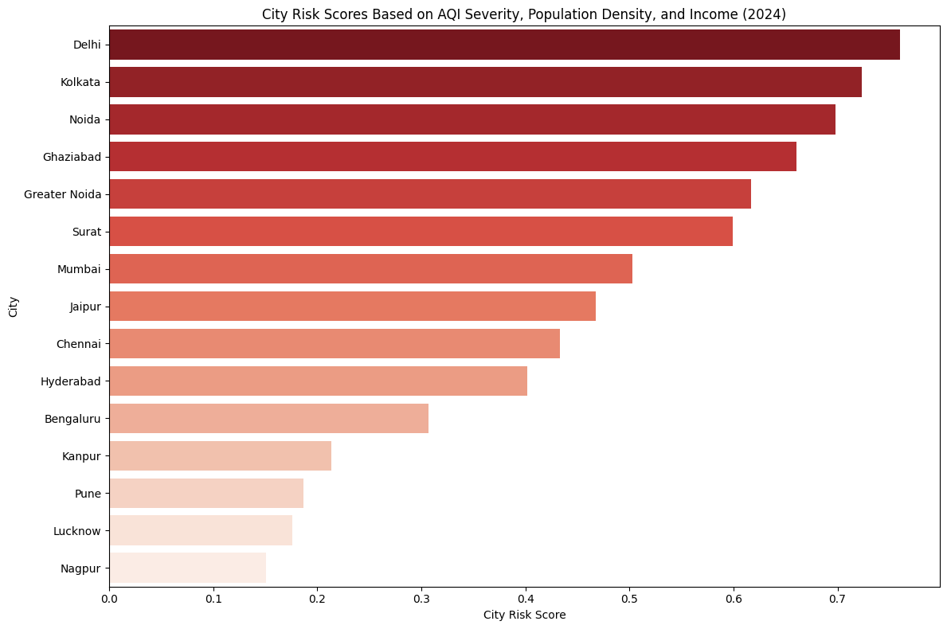
City Risk Score Analysis – Key Insights (2024–25)
Dataset built from trusted sources: AQI (AQI.in, IQAir, Drishti IAS), population density (Census, Wikipedia), and income data (Home Credit India, Economic Times, NoBroker).
Risk scores combine: Average AQI severity, population density, and monthly income for each city.
Highest risk cities: Delhi, Kolkata, Noida, Ghaziabad, Greater Noida – high pollution + dense population + strong market potential.
Delhi ranks #1: Most acute air quality & urban risk, demanding immediate intervention.
Moderate risk cities: Surat, Mumbai, Jaipur, Chennai, Hyderabad, Bengaluru – density & income matter, but AQI is somewhat lower.
Lowest risk: Kanpur, Pune, Lucknow, Nagpur – better air and/or lower density/income – reduced overall risk.
Strategic focus: Prioritize top risk cities for urgent health, policy, or product action; target mid-tier for campaigns/upgrades.

Slide 25
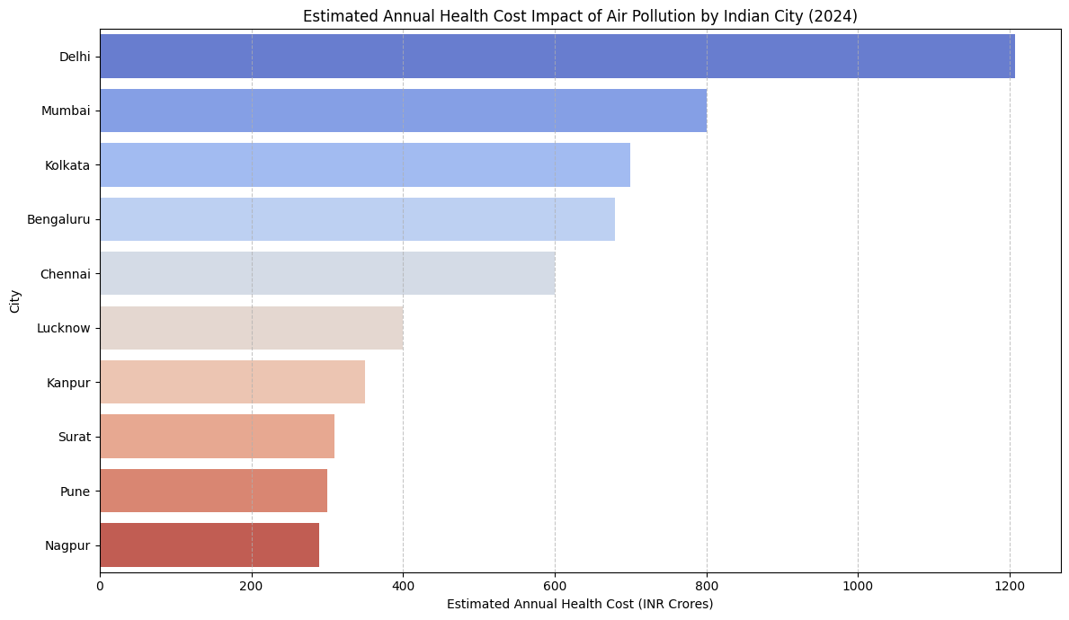
Health Cost Impact Projections – Key Insights
Datasets underpinning this analysis have been created through careful research of trusted sources(Lancet Planetary Health (2020), Rural India Online (2025) etc.).
Delhi bears the highest health cost burden due to severe chronic air pollution, large population, and related diseases.
Major metros like Mumbai, Kolkata, Bengaluru, and Chennai also face substantial economic and health impacts linked to urbanization and pollution.
Smaller cities such as Lucknow, Kanpur, Surat, Pune, and Nagpur show notable health cost burdens, indicating widespread pollution consequences beyond largest metros.
The stepwise decrease in costs across cities reflects differences in pollution levels, population exposure, and local economic conditions.
This analysis highlights pollution-driven health costs as a critical issue across urban India, with urgent need for targeted mitigation in highest-burden cities.
Reducing pollution in these urban centers can yield significant savings in healthcare expenses and improve workforce productivity, benefiting overall economy.

Slide 26
Feature Gap between existing Air Purifiers
Feature | Coway | Philips | Dyson
HEPA Filtration (True HEPA H13) | Yes | Yes | Yes
Activated Carbon Filter | Standard | Standard | Advanced
VOC and Odor Removal | Moderate | Good | Excellent
Multi-stage Filtration | Yes | Yes | Yes
Smart Sensors (PM2.5, VOCs, AQI Display) | Basic | Advanced | Advanced
App Control & Voice Assistant Compatibility | No | Yes | Yes
Noise Level (dB) | Low (32 dB) | Moderate (38 dB) | Moderate (36 dB)
Filter Life (Months) | 12 -18 | 08 -12 | 08 - 12
Coverage Area (sq ft) | 350-600 | 300-600 | 500-875
Energy Efficiency | High | Moderate | Moderate
Portability (Compact Design) | Moderate | Low | Low
Additional Features (Humidifier/Heater/Fan) | No | No | Heater, Fan, Humidifier

Slide 27
Research Summary & Strategic Suggestions for Air Purifier Development in India (2025)
Key Insights:
Children & elderly most at health risk; AQI spikes drive asthma admissions.
Pollution emergencies cause big jumps in purifier demand, especially in high‑risk metros.
Gaps in current products: real‑time AQI syncing, multipollutant sensing, compact/portable designs, health‑focused modes.
Delhi, Kolkata, Noida, Ghaziabad, Greater Noida = top priority markets.
Air pollution costs cities hundreds to thousands of crores annually in health burden.
Suggestions:
Launch compact, energy‑efficient purifiers with smart AQI & multi‑pollutant sensors.
Add child/elderly health modes, better filter alerts, easy replacements.
Target high‑risk, high‑income metros first; expand to Tier‑2 cities.
Educate consumers on AQI & indoor air quality; build trust with reliable data.
Align products with government clean‑air initiatives.

Slide 28
References & Resources Used
AQI & Pollution Data: AQI.in, Drishti IAS, IQAir.
Demographics: Census of India, Wikipedia city population density.
Income Data: Home Credit India, Economic Times, NoBroker rankings.
Health & Economic Impact: Lancet Planetary Health, ISB Blog, Rural India Online, Economic Times, World Bank, WHO/GBD.
Policy Reports: NCAP docs, CREA 2025 report, CPCB AQI portal, CSE Winter Analysis.
Market & Consumer Data: Google Trends, brand websites (Coway, Philips, Dyson), Amazon/Flipkart reviews.
Additional: Slideshare (template), Flaticon (icons), Codebasics (guidance), OpenAI/Perplexity AI (research & analysis).

Slide 29
Thank You
Google Colab Notebook Link: (Click Here)
GitHub Repository Link: (Click Here)
AVIK SARKHEL

